Slide 1
Walkers Knowledge
Pablo Amorín Valle.
Gabriel Ballesteros Melero.
Daniel Coronado Martín.
Carlos Gregorio Ruiz.

Slide 2
01 Player Knowledge
02 Minion Knowledge
INDEX

Slide 3
01 Player knowledge

Slide 4
Objectives
Pick as much pick-ups as you can
Don’t collide with minions while going for the pick-ups

Slide 5
Dependencies
Pick as much pick-ups as you can
Position of the pick-ups(V3)
Position of the player(V3)
Debug line to the pick-up
Don’t collide with minions while going for the pick ups
Position of the player(V3)
Position of the minions(V3)
Debug line to the pick-up and collisions with the minions

Slide 6
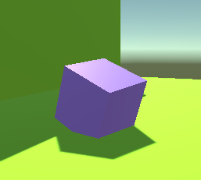
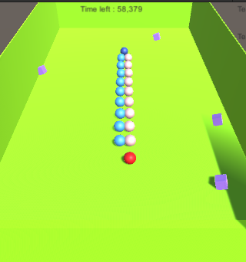
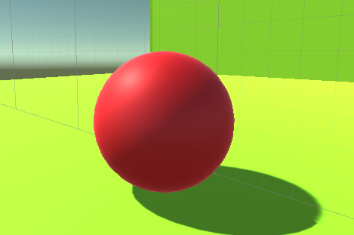
Considering Profit position, we select the one with no minions in the middle which is the closest one to the player subtracting the distance of the player and the profit.

Slide 7
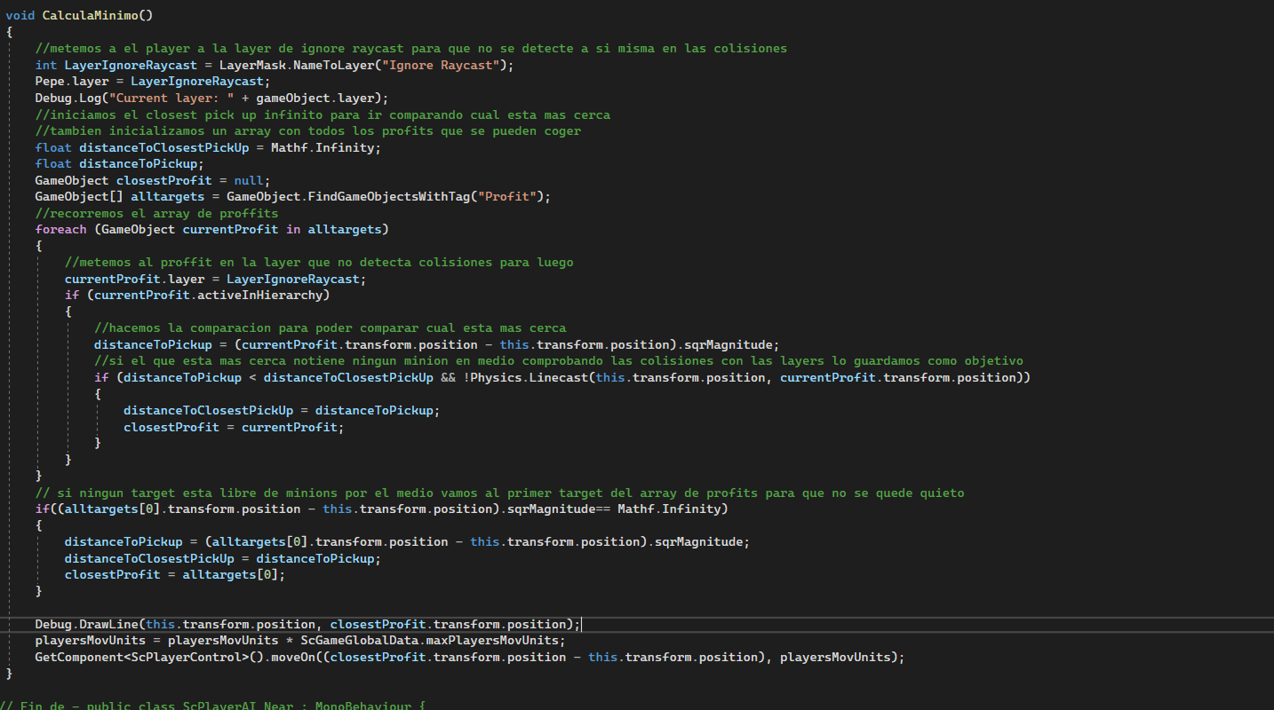

Slide 8
02 Minion knowledge

Slide 9
Objectives
Defeat the opponent player.
Defend a pickup to avoid the other team to chase it.

Slide 10
Dependencies
Defeat the opponent player:
Where is the opponent player?
Defend a pickup to avoid the other team to chase it:
Where are the pickups?
Is there a minion already defending it?

Slide 11
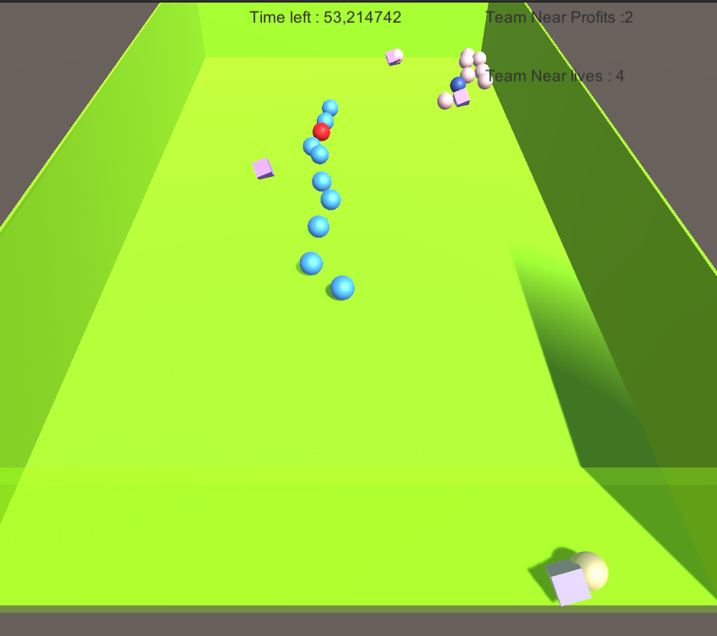
The minion will move depending on a condition:
+ If he is really close to the player, he will start chasing it and try to defeat him.
+ If the player is far from the minion, the minion will play in a defensive way, defending a profit and staying there.

Slide 12
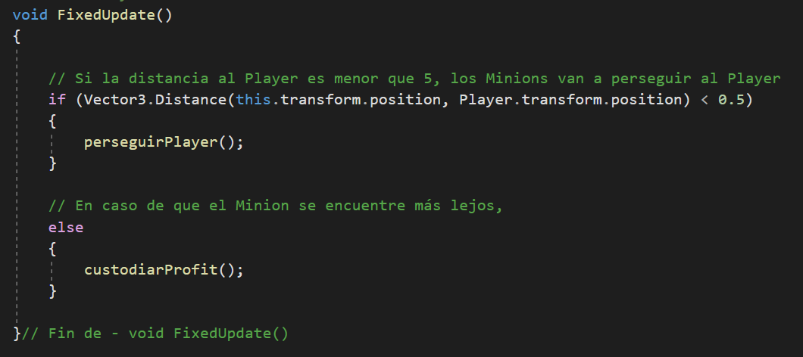

Slide 13
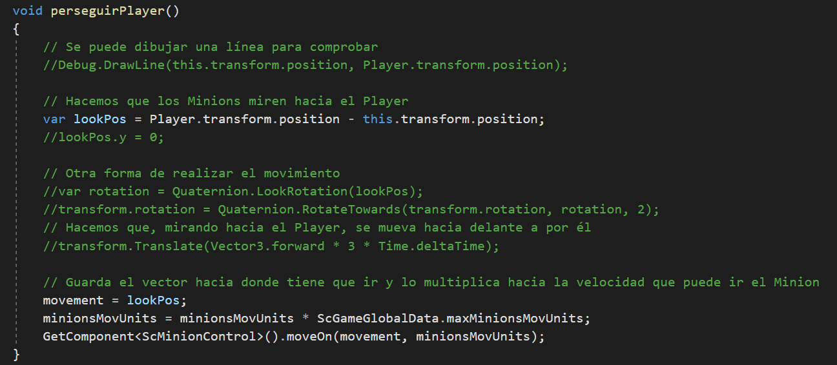

Slide 14
